Slide 1
Preliminary Results:
ActivitySim Vehicle Type Choice Model
Greg Erhardt, University of Kentucky
Mark Bradley, RSG
July 13, 2021

Slide 2
Task objectives
This is the first time a vehicle type choice model will be incorporated into an ActivitySim, DaySim, CT-RAMP or TourCast model.
The objectives are:
To implement a fully functional vehicle type choice model to work with the ActivitySim example model specification.
To also include a simple model to allocate vehicles to auto trips, for use in GHG/emissions modeling.
To make the model extendable in several different ways as part of future ActivitySim development work by RSG and/or others.

Slide 3
Topics
Data Processing & Notes
2016/2017 NHTS
Determine exclusions
Rank HH vehicles by mileage
Define alternatives
Consider vehicle age
Preliminary Model Estimation Results
Next Steps
Questions

Slide 4
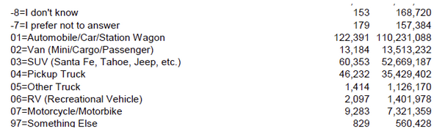
Body Type
Exclude missing/unknown body type, RV, and Something else
Combine pickup truck and other truck

Slide 5

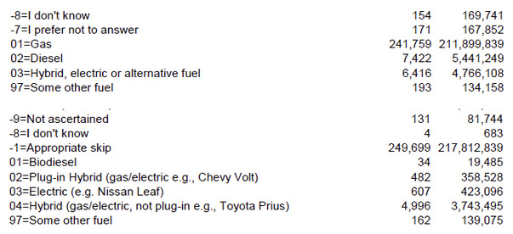
Fuel Type
Exclude missing/unknown fuel type, biodiesel, and other.
Few plug-in hybrids and electric vehicles, but may be more in future → keep as alternatives but merge coefficients
Keep diesel as alternative, but merge coefficients with gas

Slide 6
Vehicles ranked by miles driven
 | Count | Miles per Vehicle | Total Miles Driven | Cumulative Percent
RANK
1 | 123,059 | 14,384 | 1,770,064,563 | 67.1%
2 | 80,942 | 8,064 | 652,709,169 | 91.9%
3 | 30,481 | 5,274 | 160,770,163 | 98.0%
4 | 10,678 | 3,721 | 39,733,741 | 99.5%
5 | 3,589 | 2,679 | 9,614,388 | 99.9%
6 | 1,290 | 1,984 | 2,559,947 | 99.9%
7 | 507 | 1,547 | 784,439 | 100.0%
8 | 239 | 1,392 | 332,589 | 100.0%
9 | 124 | 1,157 | 143,489 | 100.0%
10 | 63 | 1,145 | 72,164 | 100.0%
11 | 36 | 801 | 28,836 | 100.0%
12 | 25 | 383 | 9,569 | 100.0%
Total | 251,033 | 42,532 | 2,636,823,057
ActivitySim vehicle ownership model stops at 4+.
Top 4 vehicles account for 99.5% of total miles driven.
Keep only 4 most driven vehicles in each household.

Slide 7
Vehicles by body type & fuel type
 | Observations |  |  |  |  | Average Annual Miles Driven per Vehicle
 | 1-Gas | 2-Diesel | 3-Hybrid | 4-Plug-In Hybrid | 5-Battery Electric | 1-Gas | 2-Diesel | 3-Hybrid | 4-Plug-In Hybrid | 5-Battery Electric
1-Car | 113,365 | 1,158 | 4,416 | 434 | 450 | 10,565 | 11,985 | 12,753 | 12,073 | 10,338
2-Van | 12,836 | 94 | 14 | 3 | 1 | 11,751 | 14,545 | 20,616 | 7,074 | 10,169
3-SUV | 58,623 | 375 | 520 | 21 | 12 | 11,879 | 12,408 | 11,806 | 12,771 | 9,809
4-Pickup/Truck | 40,907 | 5,044 | 10 | - | 1 | 10,078 | 12,186 | 14,224 | -
5-Motorcycle | 6,849 | 7 | 1 | - | 19 | 1,677 | 4,670 | 100 | - | 1,175
Keep all 25 alternatives, but combine coefficients for Gas+Diesel and PEV +BEV.

Slide 8
Vehicles by body type & fuel type & age
 |  | Observations |  |  |  |  | Average Annual Miles Driven per Vehicle
 | FUELTYPE2_TXT | 1-Gas | 2-Diesel | 3-Hybrid | 4-Plug-In Hybrid | 5-Battery Electric | 1-Gas | 2-Diesel | 3-Hybrid | 4-Plug-In Hybrid | 5-Battery Electric
1: <5 years | 1-Car | 29,052 | 395 | 1,872 | 355 | 374 | 12,598 | 13,799 | 13,619 | 12,242 | 10,594
 | 2-Van | 2,700 | 25 | 9 | 2 | 1 | 14,888 | 23,789 | 12,273 | 5,846 | 10,169
 | 3-SUV | 21,809 | 173 | 181 | 17 | 10 | 13,269 | 13,197 | 12,728 | 12,814 | 11,361
 | 4-Pickup/Truck | 7,578 | 982 | 3 | - | 1 | 13,804 | 18,211 | 12,064 | - | (9)
 | 5-Motorcycle | 1,078 | 2 | - | - | 9 | 3,206 | 11,500 | - | - | 1,601
2: 5-9 years | 1-Car | 30,782 | 356 | 1,738 | 73 | 69 | 11,420 | 13,216 | 12,515 | 11,726 | 9,740
 | 2-Van | 3,190 | 15 | 3 | 1 | - | 13,034 | 15,889 | 15,794 | 9,531 | -
 | 3-SUV | 15,550 | 78 | 190 | 3 | 1 | 12,388 | 14,673 | 11,197 | 12,436 | 1,038
 | 4-Pickup/Truck | 7,315 | 891 | 4 | - | - | 11,853 | 14,203 | 21,499 | - | -
 | 5-Motorcycle | 1,536 | 1 | - | - | 8 | 1,904 | 1,200 | - | - | 710
3: 10+ years | 1-Car | 53,531 | 407 | 806 | 6 | 7 | 8,971 | 9,147 | 11,255 | 6,329 | 2,565
 | 2-Van | 6,946 | 54 | 2 | - | - | 9,943 | 9,893 | 65,395 | - | -
 | 3-SUV | 21,264 | 124 | 149 | 1 | 1 | 10,080 | 9,882 | 11,464 | 13,038 | 3,056
 | 4-Pickup/Truck | 26,014 | 3,171 | 3 | - | - | 8,493 | 9,754 | 6,684 | - | -
 | 5-Motorcycle | 4,235 | 4 | 1 | - | 2 | 1,205 | 2,123 | 100 | - | 1,120
Few PEVs and BEVs more than 4 years old, but this is likely to change.
Rather than estimate coefficients that interact age & fuel type, draw age from a distribution afterwards.

Slide 9
Alternative-Specific Attributes from NHTS
 | Average Fuel Economy
 | 1-Gas | 2-Diesel | 3-Hybrid | 4-Plug-In Hybrid | 5-Battery Electric
1-Car | 23.9 | 31.5 | 43.7 | 41.9 | 102.1
2-Van | 19.0 | 16.1 | 37.3 | 42.0 | 113.0
3-SUV | 19.8 | 20.5 | 28.7 | 26.2 | 85.7
4-Pickup/Truck | 16.2 | 13.9 | 19.4 | 0.0 | 62.0
5-Motorcycle | 50.0 | 50.0 | 50.0 | 0.0 | 50.0
 | Number of Unique Makes |  |  |  |  | Number of Unique Models
 | 1-Gas | 2-Diesel | 3-Hybrid | 4-Plug-In Hybrid | 5-Battery Electric | 1-Gas | 2-Diesel | 3-Hybrid | 4-Plug-In Hybrid | 5-Battery Electric
1-Car | 51 | 28 | 21 | 14 | 18 | 419 | 74 | 53 | 20 | 21
2-Van | 43 | 12 | 5 | 2 | 1 | 208 | 19 | 7 | 2 | 1
3-SUV | 44 | 19 | 21 | 7 | 4 | 286 | 41 | 38 | 9 | 4
4-Pickup/Truck | 41 | 21 | 4 | 0 | 1 | 188 | 45 | 6 | 0 | 1
5-Motorcycle | 23 | 2 | 1 | 0 | 2 | 58 | 5 | 1 | 0 | 2
While we can tabulate these variables, they do not vary across observations, so we can’t estimate a coefficient.

Slide 10
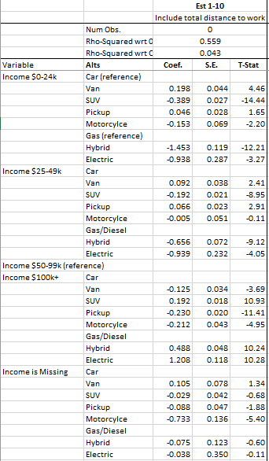
Preliminary estimation results
(part 1)

Slide 11
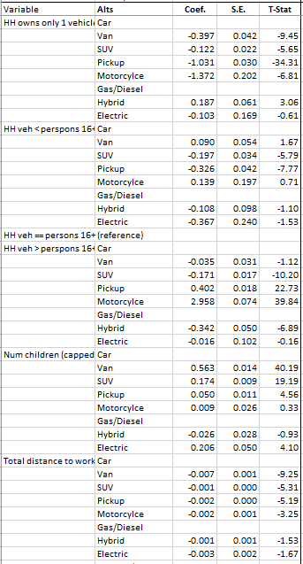
Preliminary estimation results
(part 2)

Slide 12
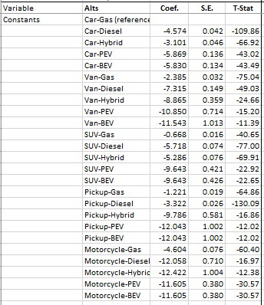
Preliminary estimation results
(part 3)

Slide 13
Next steps
1. Refine specification
Refine income & demographic variables
Additional land-use variables
  NHTS categories: rural, suburban, small town, urban, second city
  Population density category
  MSA-specific dummies?
Vehicle types already chosen.
  2+/3+ pickups, 2+/3+ vans, 2+/3+ EVs, etc.
  To implement: rank vehicles by mileage & apply in order
2. Draw vehicle age from distribution of body type, fuel type & income
3. Allocate trips/tours to vehicles.

Slide 14
Questions
Does ActivitySim vehicle ownership model count motorcycle? We should be consistent.
What “knobs” do ActivitySim users want for the future?
  Ability to vary constants, number of makes/models available, fuel economy, charging infrastructure
Other question?

